Slide 1

20 Rules of Subject Verb Agreement
Can’t we all just get along?

Slide 2

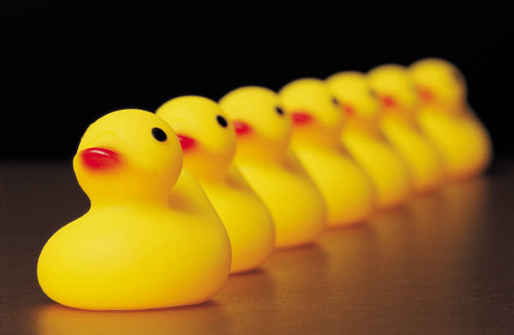
1. Subjects and verbs must agree in number.
Singular subject = singular verb
Plural subject = plural verb
Cow= singular, eats= singular
Ducks= plural, quack= plural
*Hint*= SVS- singular verbs have an S
Singular yes?- the verb has an “S”!
Singular no? The “S” has to go!

Slide 3

2. Don’t get confused by the words that come between the subject and verb.
The detective who was called to the case is usually very good.

Slide 4


3. Prepositional phrases between the subject and verb usually do not affect the agreement.
The biker in this race is very competitive.
The bikers in this race are very competitive.

Slide 5
4. If a sentence starts with “there” or “ here”, the subject will always be placed after the verb.
There is a meeting today.
Here are the results from this past month.

Slide 6
5. Subjects can come after the verb in questions.
Does Betty always play with dolls?
How are the Bosco sticks today?

Slide 7
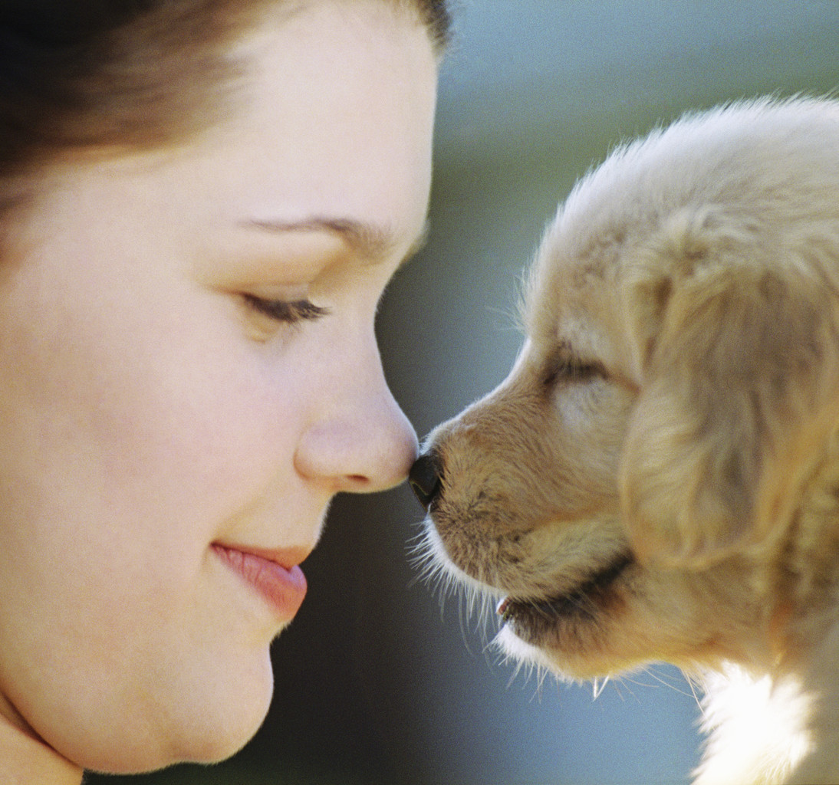
6. If two subjects are joined by “and”, they typically require a plural verb.
The puppy and the lady are friends.

Slide 8
7. If two subjects are separated by “and” refer to the same thing, the verb is singular.
Spaghetti and meatballs is my favorite pasta dish.

Slide 9
8. If both subjects are singular and connected by or, nor, neither/nor, either/or and not only/but also, the verb is singular.
Sally or Bubba has stolen the scarecrow.
Not only the guitar player but also the drummer was soaked with sweat.

Slide 10
9. If both subjects are plural and connected by the words or, nor, neither/nor, either/or, and not only/but also, the verb is plural.
Cookies or brownies are nice treats for your teacher.

Slide 11

10. If one subject is singular and one plural and are connected by the words or, nor, neither/nor, either/or, and not only/but also, use the subject that is nearest the verb.
Either my sisters or my mom has sent me a present.
Not only Bob but also the Smiths want some hamburgers for supper.

Slide 12

11. Units of measurement usually use a singular verb.
Six gallons of paint was used on the house.
Five dollars is too much for a cup of coffee.

Slide 13
12. Collective nouns usually take a singular verb.
The herd is stampeding.
The class was ready for the test.

Slide 14
13. Titles of books, movies, novels, etc. are treated as singular.
Holes was one of my favorite books.I want to see the movie.

Slide 15
14. Two infinitives separated by and take a plural verb.
To run and to read are my two favorite “Free-time” activities.

Slide 16
15. Gerunds alone take a singular verb. Gerunds linked by and take a plural verb.
Dancing is not something everyone can do as well as I can!

Slide 17

16. If the words each, every or no come before the subject, the verb is singular.
Each boy and girl has to take the test.
Every frog and toad turns into a prince.
No paper and pen is required.
(But an apple would be nice!:)
Dancing and singing come naturally to me!

Slide 18
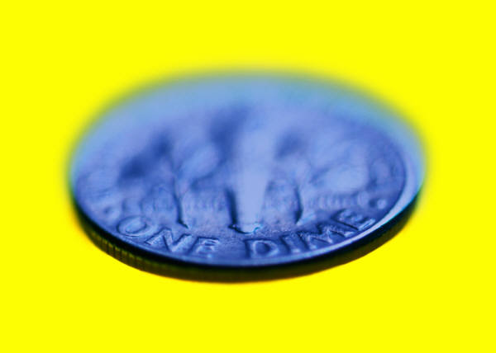
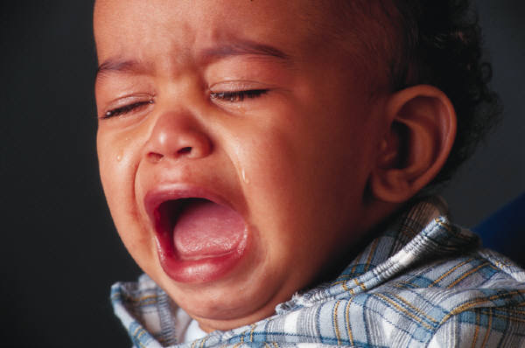
17. Most indefinite pronouns take singular verbs.
one | body | thing
someone | somebody | something
anyone | anybody | anything
No one | nobody | nothing
everyone | everybody | everything
Little One * Everybody is happy.
Another Neither * No one has a dime.
Much Either * Nothing was going to help.
Each

Slide 19
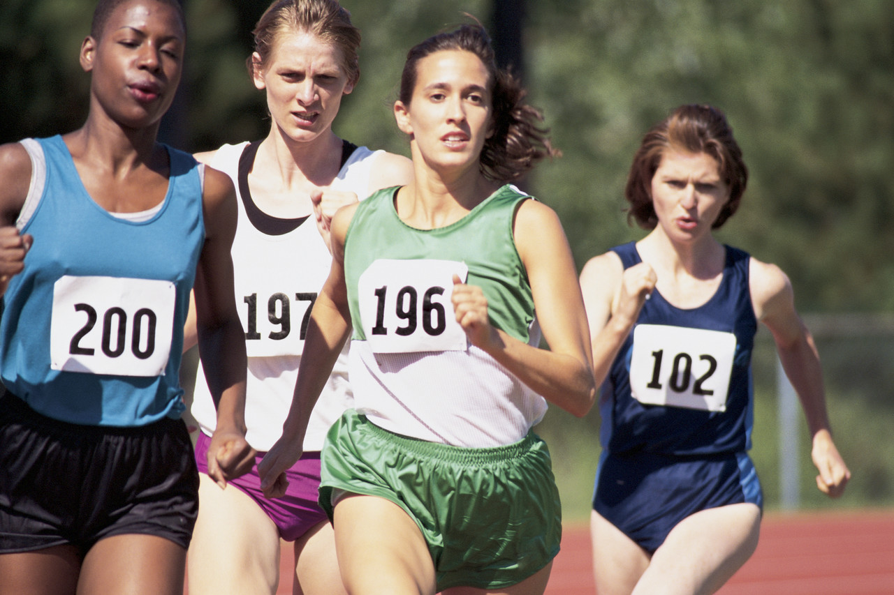

18. Both, few, many, others, and several take a plural verb.
Several need to finish the race.
A few have the right answer.

Slide 20
19. When the subject is all, any, more, most, none, or some, this is the ONLY time you must look at the object of the prepositional phrase to determine whether it is singular or plural.
All of the chickens have laid eggs.
Some of the milk has spilled.

Slide 21
Final rule- Remember, only the SUBJECT affects the verb!

